Slide 1
DeepskyLog 5.0
What to expect

Slide 2
New Layout
Bootstrap
Responsive
Easy to use framework
TableSorter
Sorting
Movable columns

Slide 3
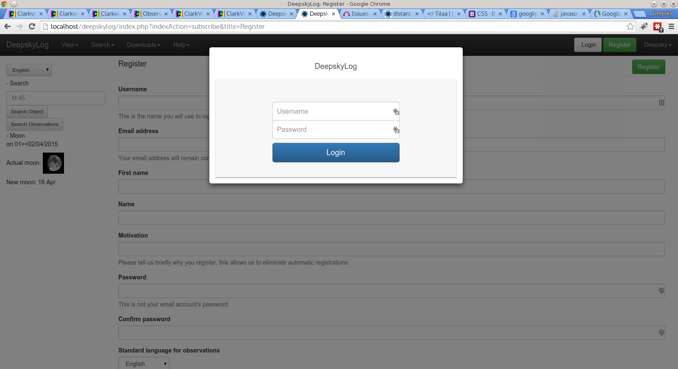

Slide 4
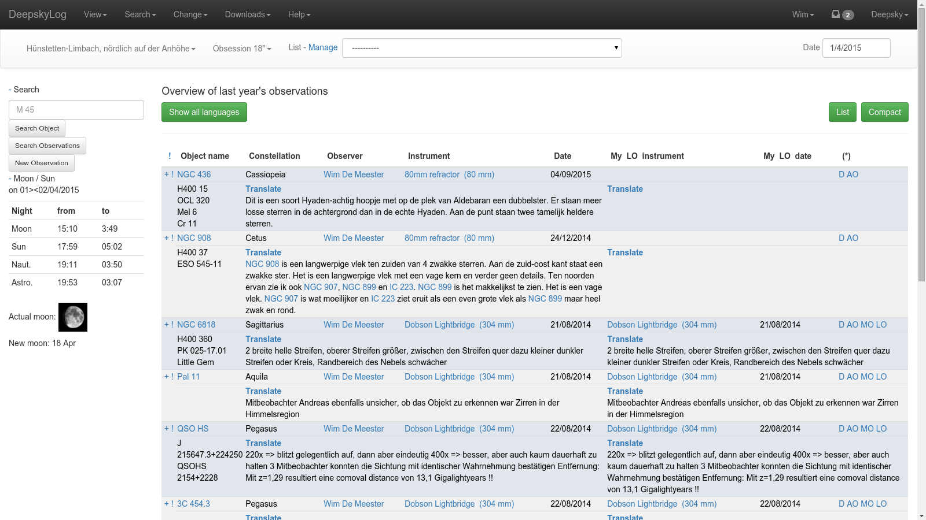

Slide 5
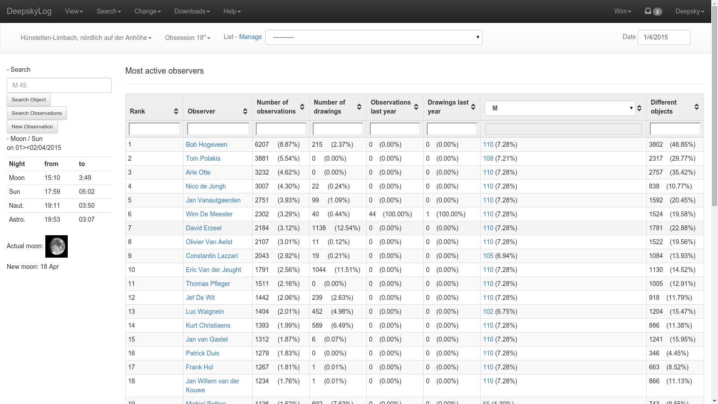

Slide 6
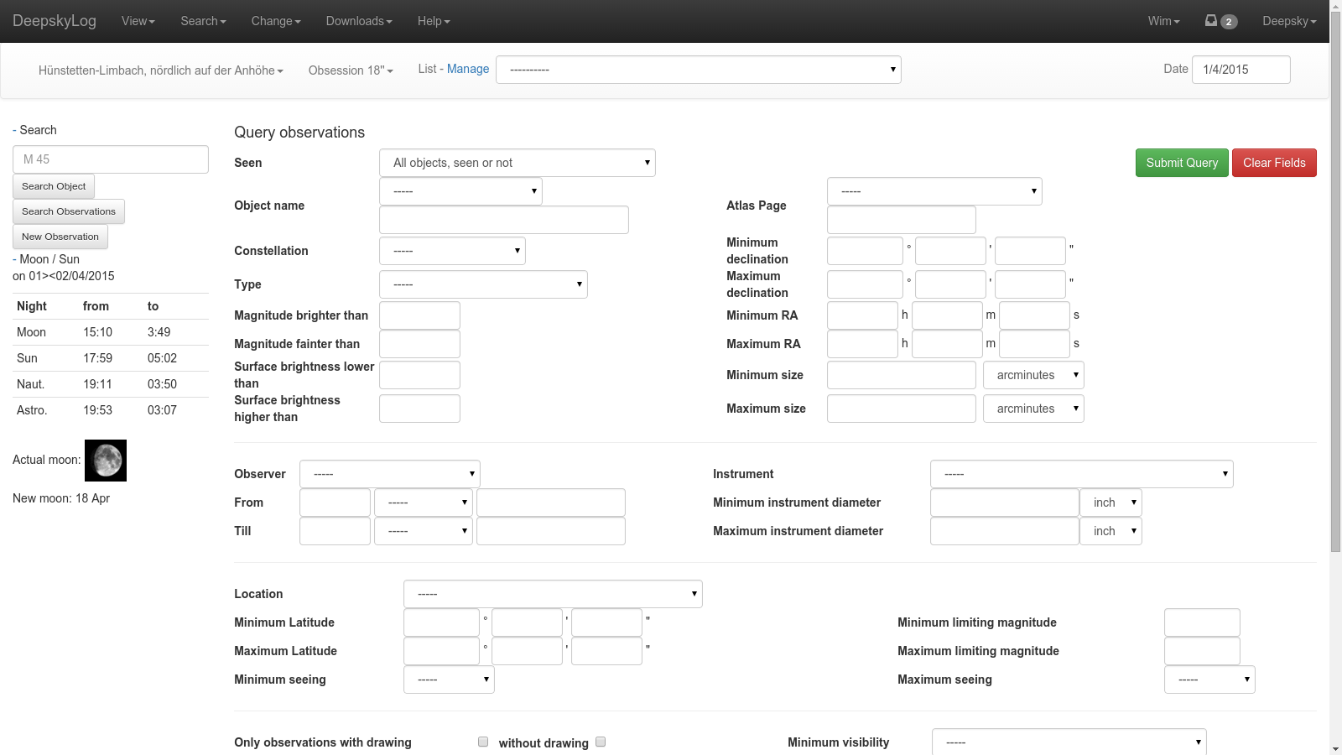

Slide 7
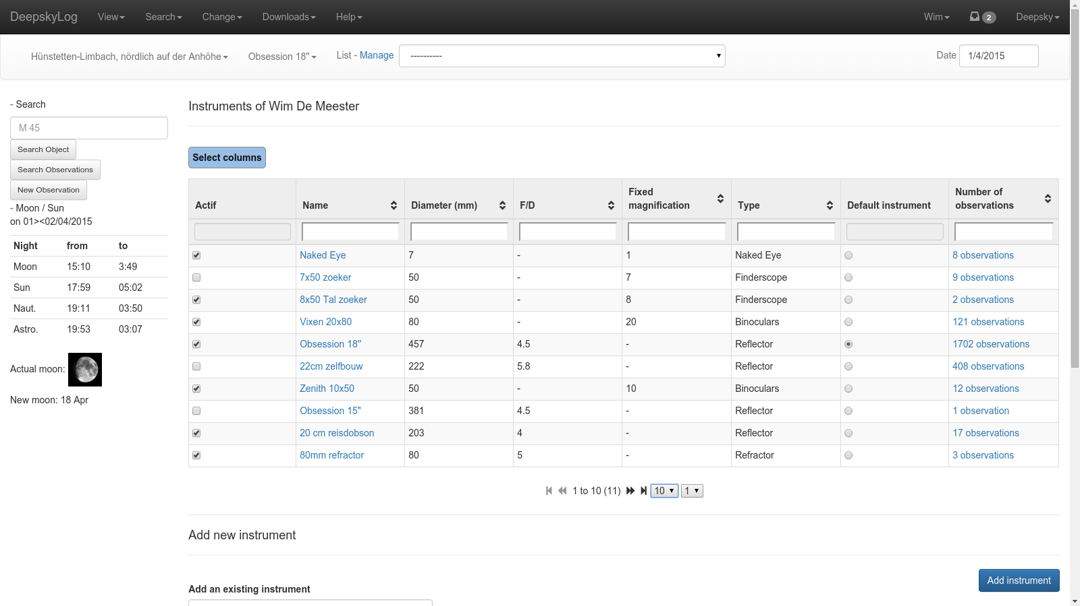

Slide 8
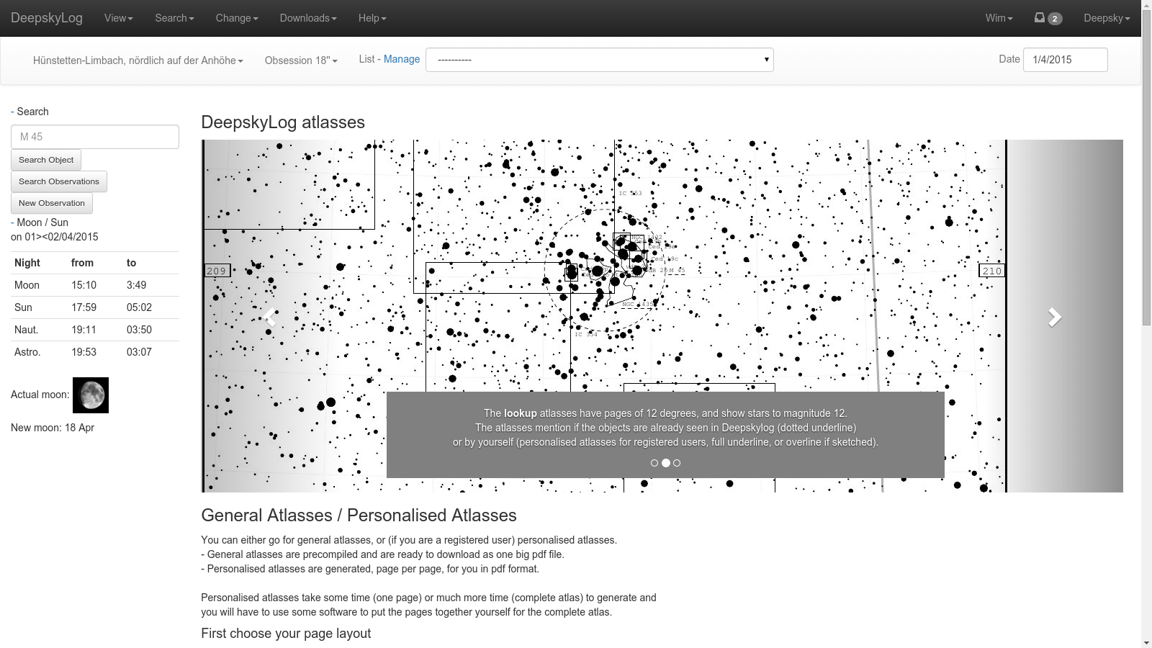

Slide 9
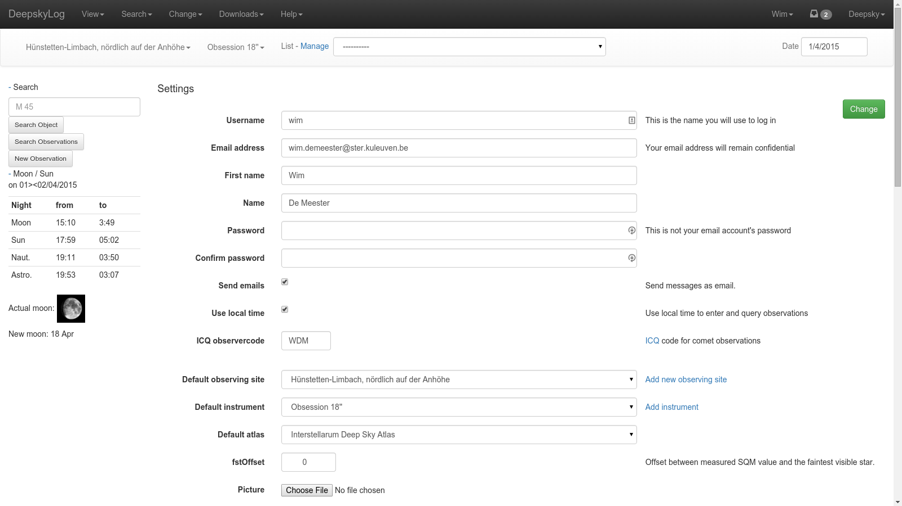

Slide 10
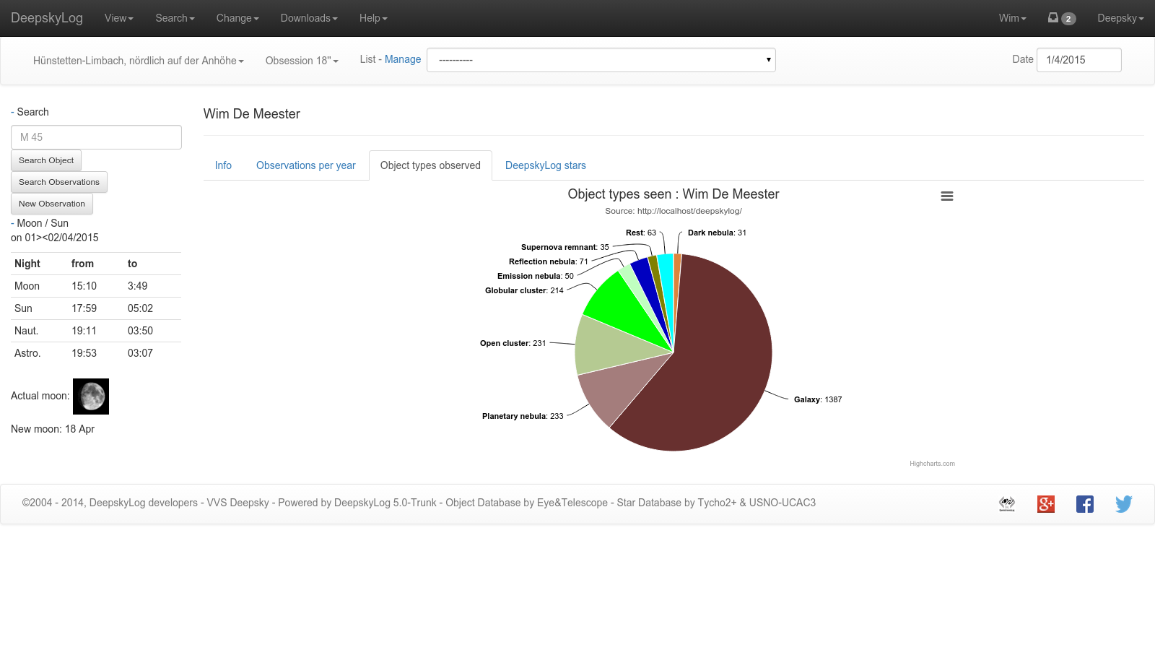

Slide 11
DeepskyLog Stars
Gamification
Automatic message
Deepsky and comets
Descriptions and drawings

Slide 12
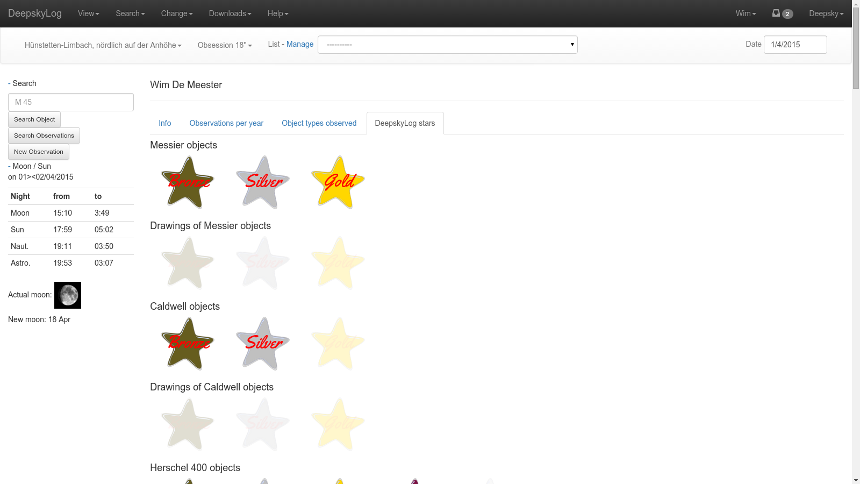

Slide 13
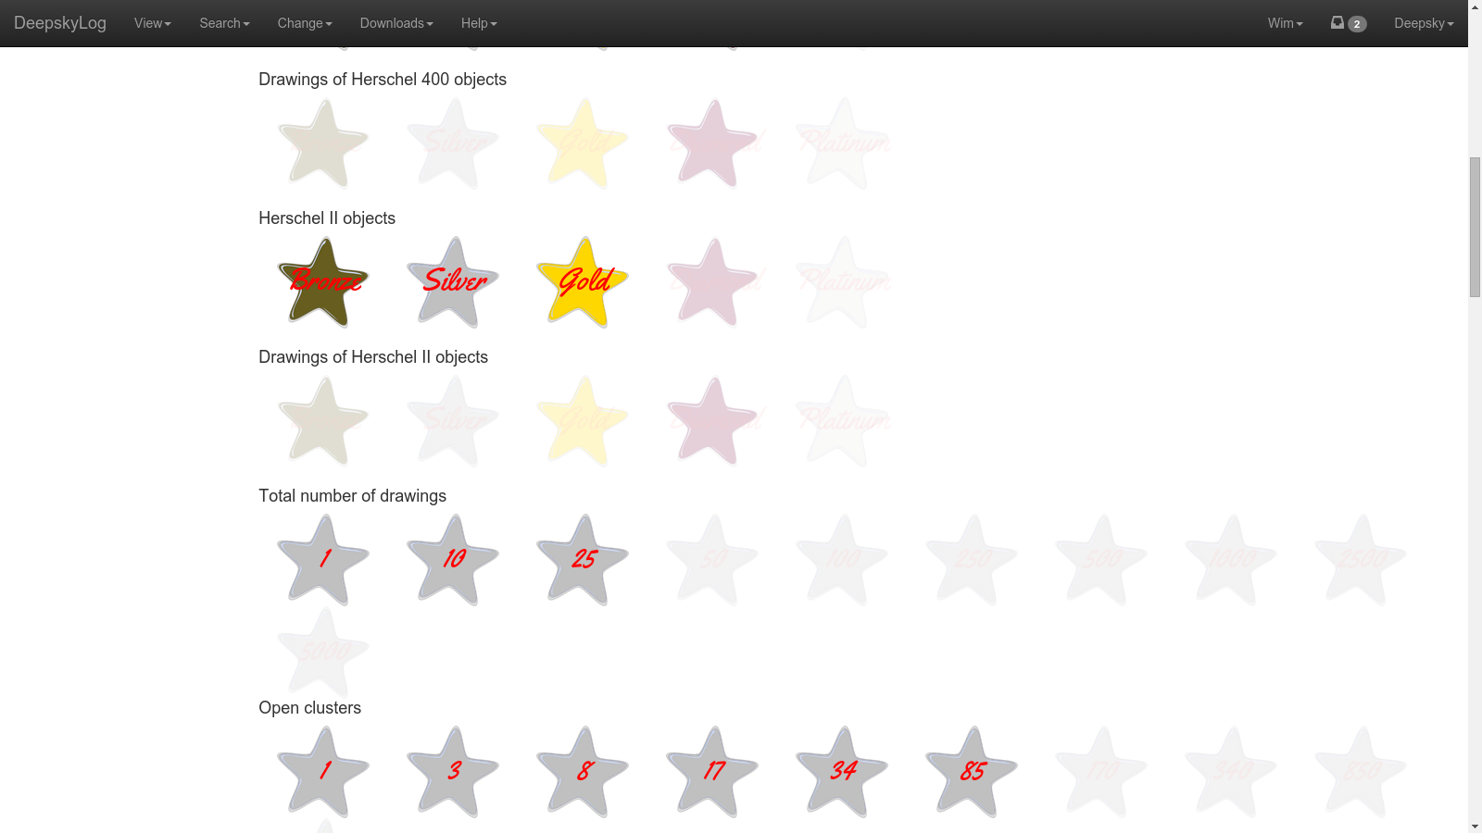

Slide 14
Use real emailaddress
Send message to real email address

Slide 16
Database access
Old mysql methods:
deprecated since php 5.5.
no longer developed since 2006
Migration to PDO_mysql

Slide 17
Picture of observers
In detail of observation.
In messages.

Slide 18
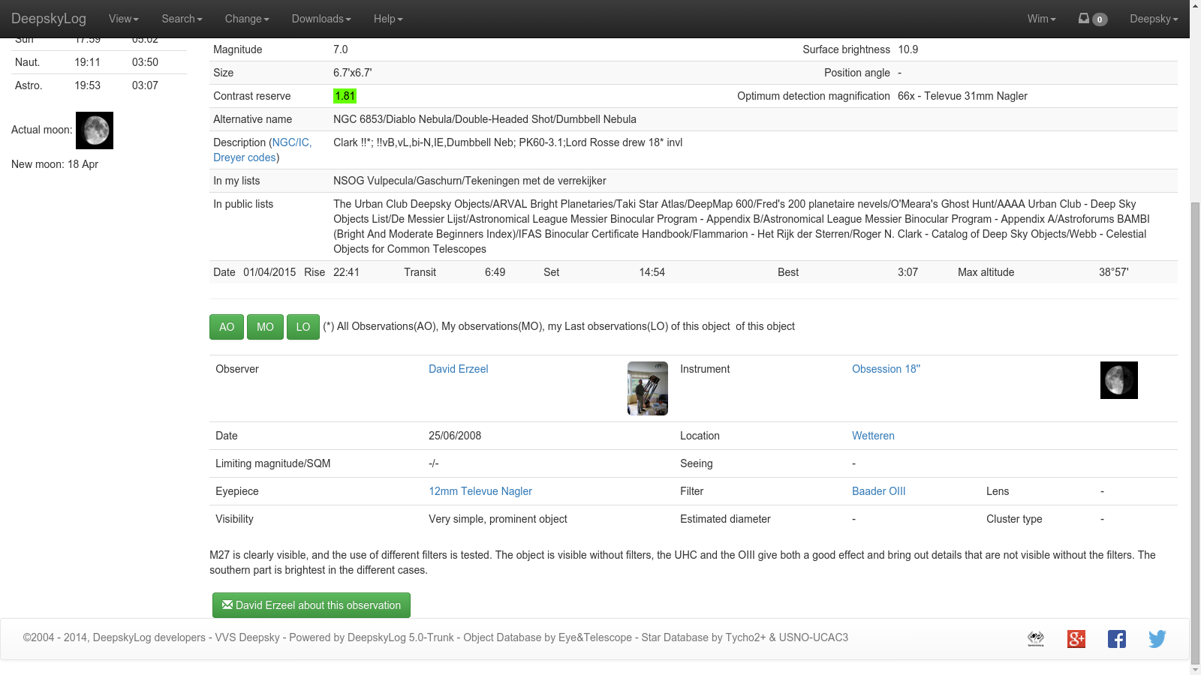

Slide 19
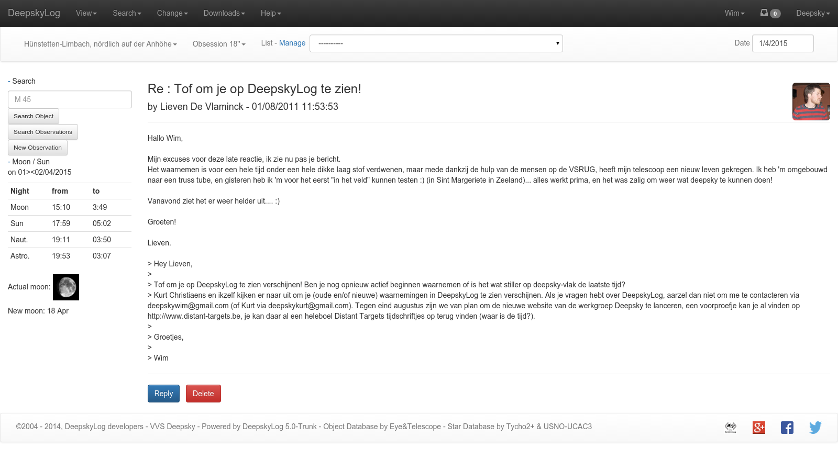

Slide 20
New Logo
Almost ready

Slide 21
New entry page
Needs new logo

Slide 22
Add locations
Still todo:
Add SQM / Limiting magnitude
Adapt location
Show locations on map, together with all other locations.
Write script to adapt the old locations
Import/export using OAL should use the elevation.

